Slide 1
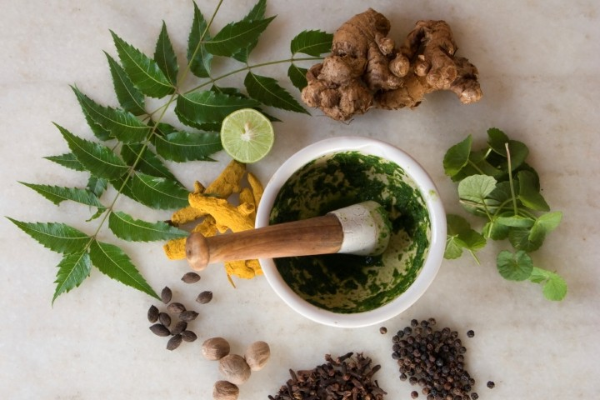
Herbal Medicine
Dr.S.KALA,
Associate Professor,
Department of Botany,
Seethalakshmi Ramaswami College,
Tiruchirappalli

Slide 2
Healthy hair
The most effective remedy for natural hair growth is the use of coconut milk because it is rich in iron, potassium and essential fats.
Take coconut milk from a fresh coconut and half a squeeze of lemon. Apply it on your scalp. Leave it for 4-5 hours and rinse it.
Cocus nucifera
Tablespoon of fenugreek seed and water should be made into a smooth paste. Add a little coconut oil (or milk) to it and apply on your hair and scalp for half an hour. and wash it
Trigonella foenum graecum
This magical fruit is a powerhouse of nutrients. It’s rich in Vitamin C and that accelerates hair growth.
Mix 2 teaspoons of amla powder with equal amounts of lime juice and let it dry. Rinse it off with some warm water. It will also prevent hair pigmentation.
Phyllanthus emblica
Eggs contain high levels of proteins , sulphur, zinc, iron, selenium, iodine & phosphorous. Separate one egg white in a bowl and add one teaspoon of olive oil and honey. Make a paste of it and apply it all over your hair and scalp for about 20 minutes and rinse it .

Slide 3
It is commonly mixed with coconut as a conditioning oil or sesame oil for use hair growth treatment.
This herb is mostly used in hair tonic preparations to combat hair loss and premature greyness.
Eclipta prostrata
Henna leaves are powdered, mixed with water, and rested for a few hours. The paste is then applied to the hair and left in for a couple of hours. It is rinsed off with water.
Lawsonia inermis
Henna is commonly for hair coloring, but it also works wonders for the overall health of your hair.
Neem oil boosts the rate of hair growth and increases the tensile strength of the hair shafts, making them silky and adding shine. It reduces hair loss and irritation of the scalp
Neem leaf pastes can be used as conditioning packs to nourish the scalp and prevent dryness and flaking.
Azadirachta indica
Healthy hair

Slide 4
Skin care
Basil is a good cleanser and tonic for skin.
Basil has been used for thousands of years as an anti-aging remedy due to the high antioxidant content which prevents free radicals from damaging skin cells.
Ocimum basilicum
Rose Petals have a cleansing, astringent, toning, moisture retaining, stimulating and soothing effect.
Rose is beneficial to dry, sensitive skin, it is also great fro mature skin as it may help to prevent wrinkles and fine lines
Rosa sp.
Haldi helps to keep the skin looking young and fresh.
As it contains many antioxidants, it is great for aging skin. It helps stimulate new cell growth and help keep the skin’s elasticity intact.
Curcuma domestica

Slide 5
Skin care
Great for treating skin ailments, fading scars and black spots
Adds glow to the skin.
Hedychium spicatum
Avarampoo is wonderful for using in external application and it treats many skin problems.
It keeps the skin from infections and the best way to use it for external application is by including it in face wash powder.
Cassia auriculata
Fights acne and pimples. Removes excess sebum and oil.Deep cleanses skin removing dirt, sweat and impurities. Evens out skin tone and brightens complexion. Treats tanning and pigmentation
Mix equal quantities of orange peel powder and multani mitti, blend the two together with the help of rosewater apply on your face, let it dry and wash off.

Slide 6
Eye care
Amla prove to be very beneficial for your eye health. Firstly, amla can help improve your overall eye health and preserve your eyesight if taken regularly. Amla strengthens your eye muscles which can actually enhance your vision. It also helps soothe your eyes when irritated and can prevent cataracts from forming
Rose water contains many antiseptic and antibacterial properties. This helps irritation, redness and inflammation in eyes caused due to dust, dirt and infections. Rose water can also reduce dark circles
Add 1 tbsp of raw organic honey to the bottle.
Shake well and add one drop in each eye twice a day.
Fill the rest of the bottle with distilled water.

Slide 7
Ear care
Garlic has natural pain relieving qualities, making it highly effective in the treatment of ear infections.
Make garlic oil by cooking two garlic cloves in two tablespoons of sesame oil or mustard oil until it turns blackish. Strain the solution. When it is bearably hot, use two to four drops of this oil in the infected ear as ear drops.
You can also use holy basil to treat minor ear ache and ear infections. It can relieve ear pain as well as reduce infection.
Crush four to five fresh holy basil leaves gently to extract the juice. Apply the basil juice on or around the infected ear. Avoid getting the juice in the ear canal.
Onion works as a wonderful herbal remedy to treat ear infections. Chop an onion, microwave it for a couple of minutes, and add a few drops of the liquid so obtained after microwaving to the infected ear.

Slide 8
Respiration
Tulsi is the Queen of the Herbs.
Helpful to fight with air borne pathogens due to environmental changes.
Tulsi helps in respiratory support and useful in seasonal variation.
Ocimum Sanctum
A good remedy for a cough and cold or flu is eucalyptus oil. It helps expel phlegm and decongests the airways.
Apply a few drops of eucalyptus oil on a soft cloth and placing it just below your pillow cover.
Take a few drops of eucalyptus oil and add it to a vessel of boiling hot water. Carefully place your face over the vessel and inhale the vapours.
Eucalyptus globulus
Pepper has been used for cold remedies for centuries. Pepper increases circulation and has anti-microbial properties, which kill pathogens. Adding pepper into the healing equation may speed the cure of cold.
Piper nigrum

Slide 9
Cold
Almost everyone would have heard or used it for treating cough and cold. It is a decoction made out of boiling thoothuvalai, peppercorns, garlic pods and turmeric. This decoction is very effective for chest congestion, cough, blocked nose and even for people who suffer from sinus infection.
Solanum trilobatum
Ginger is said to contain twelve antiviral substances. Ginger treats all the symptoms associated with a cold: sore throat, inflammation of the mucous membranes, coughing. Asthma sufferers with a cold are advised to use ginger.
Zingiber offinalis
Garlic is a powerful antioxidant with antimicrobial, antiviral and antibiotic properties. It also provides decongestant and expectorant effects.
Allium sativum

Slide 10
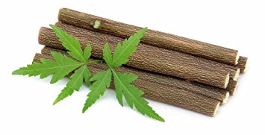
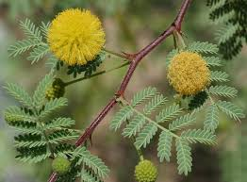
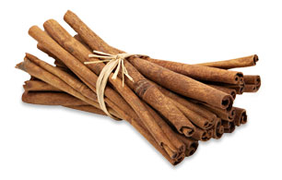
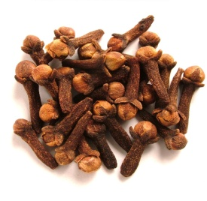
Dental health
Traditionally, sticks of neem were used as a natural toothbrush due to its strong antibacterial properties. .It is able to reduce plaque, prevent cavities and gum disease, and freshen breath.
Cinnamon is rich in calcium, making it a great way to strengthen the teeth and jaw. It is also anti-microbial and a mild pain reliever.
Bark is used for Gum diseases and mouth ulcer
Powdered acacia can also be used in a type of herbal toothpaste to clean teeth without being too abrasive to the surface of your teeth.
Clove oil in major drugstores labeled to cure toothaches with just a few drops to the infected tooth cavity.
The salt water will break up any food stuck in between teeth and kill any bacteria that may be causing damage. It is also a great way to ease pain and reduce inflammation from infection of the gums.

Slide 11
Peppermint has the ability to give the mouth a fresh, clean feeling. Essential oils from peppermint does much more than create a fresh feeling.
Clove is an effective component of mouth rinses
A spoonful of lemon with a pinch of salt can remove garlic and onion breath after a meal. This is an effective and easy to employ remedy for bad breath.
Cardamom is often taken after meals and should chewed. This produces an oil and the taste of your mouth is improved. This is the simplest home remedy for bad breath.
Bad breath

Slide 12
Heart
A single clove of garlic consumed every day can help to reduce the production of ‘bad’ LDL cholesterol, raise the production of ‘good’ HDL cholesterol and also keep blood pressure within normal limits.
Allium sativum
Although it’s best known for its digestive and anti-flatulent properties, ginger is increasingly gaining recognition as a herb that promotes heart health. It is capable of preventing formation of clots, improving blood circulation and lowering LDL cholesterol levels.
Zingiber offinalis
Onion can help decrease levels of unhealthy fats in the blood, prevent clot formation and lower blood pressure.
Allium cepa

Slide 13
Liver
The Indian gooseberry or amla is known as one of the richest source of vitamin C. It keeps the liver functioning at optimal levels.
Emblica offinalis
Packed with valuable antioxidants, turmeric is an important herb that improves liver health.
The antiviral action of turmeric is effective in preventing multiplication of the viruses causing hepatitis B & C
Curcuma domestica
Beet, cabbage, carrot, broccoli, onion and garlic are some vegetables having potential to help the liver secrete enzymes helping in the production of carcinogenic substances
Kilanelli shows potential to prevent liver damage.P. niruriprotects liver tissues and helps stimulate the liver to repair itself.
Phyllanthus niruri

Slide 14
Cumin is extremely good for digestion and related problems. The very aroma of its essential oil facilitates the primary digestion of food.
Ginger has classically been used to improve the digestion process.
Nine different substances provide benefits to the gastrointestinal system.
,
Peppermint when used correctly can help relieve indigestion, gas and irritable bowel condition
Curcuma domestica
Cuminum ciminum
Mentha picata
Digestion

Slide 15
Constipation
Raisins
They are packed with fibre and act as great natural laxatives. This remedy also works wonders for pregnant women, without the side-effects of medication
Figs
Either dried or ripe, figs are packed with fibre and act as a great natural laxative
Spinach This has properties that cleanse, rebuild and renew the intestinal tract.
Guavas have soluble fibre in the pulp and insoluble fibre content in the seeds . They also help with the mucus production in the anus and with peristalsis
Lemon
It acts as a cleansing agent for the intestines, the salt content helps in quick and easy passage of stool.
Castor oil
This has been used as a sure shot remedy for constipation and has properties that can kill intestinal worms.

Slide 16
Diabetes
Use curry leaves in your daily cooking. Add them to salads and dips and even in gravies, sauces and curries.
Chew 8-10 fresh curry leaves in the morning.
Murraya koenigii
Drinking okra water helps lessen diabetes symptoms.
The drink is made by putting okra pods in water and soaking them overnight. Some of the valuable nutrients in the skin and seed pods will be absorbed into the water.
Abelmoschus esculentus
Jamun seeds are extensively used to cure diabetes.
Have 1- to 1- ½ tsp of jamun powder mixed with water every morning on an empty stomach.
Syzygium cumini

Slide 17
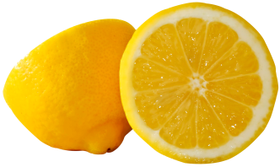
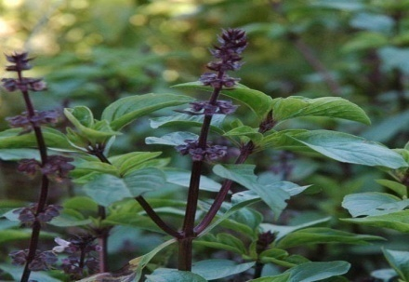
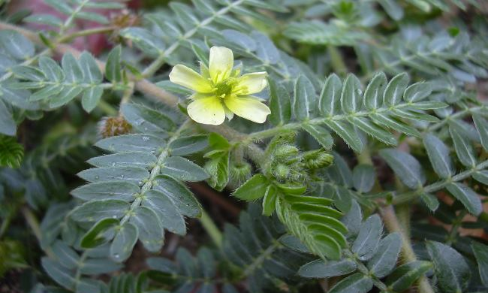
Kidney stones
Lemons contain citrate that prevents calcium stones from forming. Citrate can also break up small stones, allowing them to pass more easily.
Citrus limon
Pomegranate juice can help improve overall kidney function, as well as flush stones and other toxins from your system.
Punica granatum
Basil contains acetic acid, which helps to break down the kidney stones and helps to reduce pain. It also lowers uric acid levels, which reduces your risk for future stones.
Ocimum sanctum
It helps to dissolve the kidney stones. It promotes urination and soothes and cools the urinary tract membranes to facilitate the elimination of the kidney stone.
Tribulus terrestris

Slide 18
Diabetes
Cinnamon may help lower blood sugar and fight diabetes by imitating the effects of insulin and increasing glucose transport into cells. It can also help lower blood sugar by increasing insulin sensitivity, making insulin more efficient at moving glucose into cells.
Add 1 tsp of cinnamon powder in 1 cup of warm water. Drink this daily. Cinnamomum verum
Fenugreek seeds are high in soluble fibre, which helps lower blood sugar by slowing down digestion and absorption of carbohydrates. This suggests they may be effective in treating people with diabetes.
Take 4 tablespoons of fenugreek seeds and soak them in 250 ml water overnight. Crush the seeds in the morning and strain to get the water. Have this water everyday in the morning for at least two months.
Trigonella Foenum-graecum
The herb may be prepared in a variety of different ways, and may be able to help diabetics with insulin secretion, glucose oxidation and other processes.
Take 4-5 bitter gourds and peel them and remove the seeds. Crush it to paste. Place this paste into a sieve and extract the juice. Drink this fresh bitter gourd juice on an empty stomach every morning.
Momordica charantia

Slide 19
Joint pain
Ashwagandha
It's action as one of the herbs for joint pain relates to its strong anti-inflammatory action which helps to reduce pain and the swelling
Withania somnifera
Turmeric
Root Powder of this plant is one of the best natural herbal pain remedies, its action for healing inflammation, and it is very helpful to ease joint pain due to its anti-inflammatory action.
Curcuma domestica
It is a pain killer. It promotes the production of urine, increases bowel movement, assists in digestion and possesses anti-inflammatory properties. Wel Penela is used for the treatment of back pains, joint pains and general body aches
Cardiospermum halicacabum
Sesame seeds are superior to the conventional pain relief medications in reducing osteoarthritis related knee pain.
sesame seeds are loaded with copper, a trace mineral with anti-inflammatory property. Copper helps in reducing swelling and pain in the joints.
Sesamum indicum

Slide 20
Irregular periods
Dried powder roots of Asafoetida plant is used to treat irregular periods and stimulate menstrual cycle. The herb contains chemical compounds which acts similar to the female hormone progesterone that induces increased blood flow and regularise periods
Ferula asafoedita
Turmeric is used since ancient times in treating irregular periods. The active compound in turmeric helps to regulate the uterus by removing the waste blood
Curcuma domestica
Indian Aloe has been a popular remedy for irregular periods. This herb relieves pain and scanty flow the major symptoms associated with irregular periods.
Aloe vera

Slide 21
Crush the neem leaves adding a little water to get its paste. Add turmeric powder to neem leaves paste. Apply this paste to the cracks of heels. Leave it for half an hour Wash off your feet with water. Pat dry with a soft cloth.
Add powdered roasted cumin seeds, roasted coriander and sugar, mix well. Store in a container with lid. Mix half a teaspoon of this herbal powder with half a cup of water and have it thrice a day.
Cut a lemon in two halves and take one half of it. Rub this lemon half on your feet while squeezing it so that the juice is transferred to your heels. Do this for five minutes. Now gently scrub your feet with a soft cloth or brush. Wash off with water. Take a lemon and squeeze out its juice into a feet soaking basin filled with warm water. Soak you feet in it for 15-20 minutes. Do it twice a week.
Soak your feet in warm water for 15-20 minutes. Now take the rice flour and add honey and vinegar to it to make a thick paste. Now apply this coarse rice flour scrub to your heels and rub gently. Massage for about 10-15 minutes and then wash off with lukewarm water. Do it daily till your feet become cracks free.Mix lemon juice with mashed papaya and apply this to your cracks on heels. Wash after 15-20 minutes.

Slide 22
Food to favour
Light diet , Green and black grams, Green leafy vegetables [cabbage, cauliflower, carrot, spinach, broccoli], fresh fruits [apple, papaya, orange, pineapple, peach, plums], yellow lentil [moong dal], bitter gourd, cumin seeds, black pepper, mustard oil and cucumber.
Food to Avoid
Potato, sweet potato, whole milk products, bakery products, chilled water, soft drinks, sea food, cakes, sweet bread, chocolates and junk food
Do’s
Drink lukewarm water.
Try to exercise regularly.
Don’t:
Avoid stress and anxiety in daily activities.
Avoid excessive sugary products or drinks.
Morning walk ,Nutritional diet, Yoga,
Peaceful mind, Restful sleep

Slide 23
Have our herbs healed all your problems?

Slide 24
THANK YOU

